Slide 1
Analog & Digital Communication Systems
Week 1

Slide 2
Analog & Digital Communication Systems
Instructor: Dr. Zahid Wadud Mufti
zahidmufti@nwfpuet.edu.pk
Assistant Professor
Department of Computer Systems Engineering
University of Engineering and Technology, Peshawar

Slide 3
Communication Systems
Course Objectives
To develop the basic concepts of communication systems
Text Book
Modern Digital And Analog Communication Systems by B. P Lathi, 3rd or 4th Edition
Reference books
Communication Systems by Bruce Carlson
Communication Systems 4th ed. By Simon Haykin
Digital Communication by Sklar
Analog and Digital Communication by Simon Haykin
Evaluation
Assignments 10 marks
Quizzes 10 marks
Presentation 05 marks
Mid- Term 25 marks
Final exam 50 marks

Slide 4
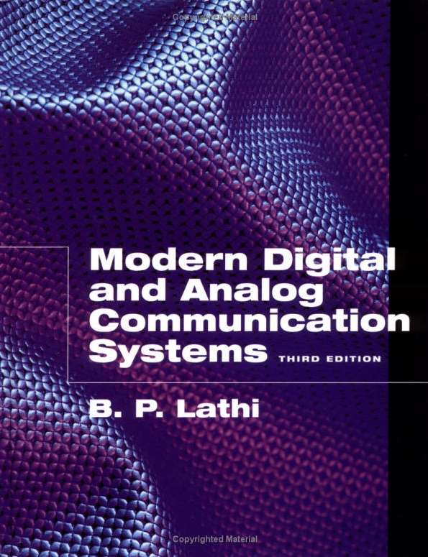
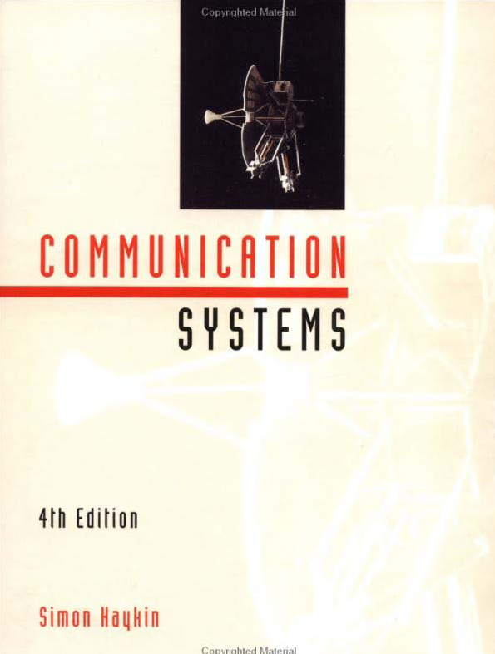
Text Books

Slide 5
Chapter 1
Introduction to Communication Systems

Slide 6
Outline
Introduction of Communication Systems
Communication System model
Attenuation, Distortion and Noise
Messages
Noise immunity
Analog to Digital conversion
Sampling
Quantization
Encoding
Bandwidth
Channel Capacity
Modulation
Randomness, Redundancy, and Coding

Slide 7
Introduction of Communication Systems
The purpose of communication system is to transport an information signal from a source to a user destination via a communication channel (transmission system)
A communication system is of an analog or digital type
In an analog communication system, the information signal is continuously varying in both amplitude and time, while for digital comm. system, the information signal is processed so that it can be represented by a sequence of discrete message.

Slide 8
Communication System model
Transmitter
Information Source
Source Transducer
Channel Encoder
Noise, Interference and distortion
Comm. Channel
Destination (User)
User Transducer
Channel Decoder
Receiver

Slide 9
Communication System model
Information source: generates the data to be transmitted. Examples are telephones and computers
Transmitter: transforms and encodes the information in such a way to be transmitted across some sort of transmission system. For example, a MODEM takes a digital bit stream from a personal computer and convert it to analog signal that can be transmitted by the telephone networks

Slide 10
Communication System model
Transmission system (Comm. channel): this can be a single transmission line or complex network connecting source and destination (wire, Coaxial cable, optical fiber, or radio link)
Receiver: accepts the signal from the transmission system and converts it into a form that can be handled by the destination device like as the MODEM
Destination: takes the incoming data from the receiver.

Slide 11
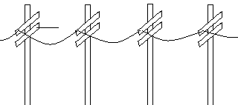
Communication System model
For Example: the workstation can be connected to the server by the following communication system




workstation
MODEM
MODEM
Server
Public telephone network
Information source
Transmitter
Receiver
destination
Transmission system (Comm. channel)

Slide 12
Attenuation, Distortion and Noise
Attenuation is the loss or reduction in the amplitude (strength) of a signal as it passes through a medium. The extent of attenuation is expressed in units called decibels (dBs)
Distortion is known as the alternation of the original signal. (If the attenuation happens in different amounts for the different parts of the signal, it is a distortion.)
The communication channel contains the noise that is classified as:
External noise includes interference, human-made noise generated by faulty contact switches, or natural noise from lightning.
Internal noise results from thermal motion of electrons in conductors, random emission, diffusion or recombination of charged carriers in electronics devices.

Slide 13
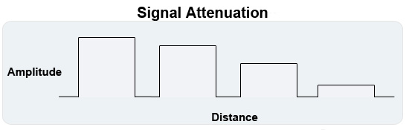
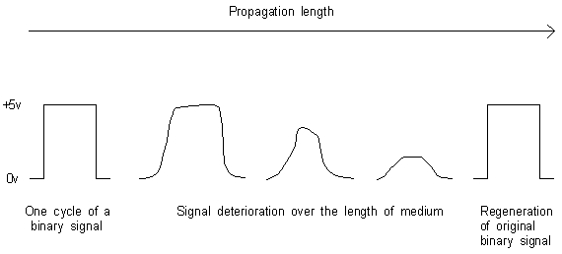
Attenuation, Distortion and Noise

Slide 14
Messages
Messages are digital or analog
Digital messages are constructed with a finite number of symbols.
For example, printed English consists of 26 letters, 10 numbers, a space. Thus, a text is a digital message constructed from about 50 symbols. Human speech is also a digital message, because it is made up from a finite vocabulary in a 1anguage. Similarly, a Morse-coded telegraph message is a digital message constructed from a set of only two symbols-mark and space. It is therefore a binary message, implying only two symbols.

Slide 15
Messages
Analog messages, on the other hand, are characterized by data whose values vary over a continuous range. For example, the temperature or the atmospheric pressure

Slide 16
Noise Immunity
Digital Signals are more Immune to noise than Analog Signal
Repeaters are used in Digital System, Long distance

Slide 17
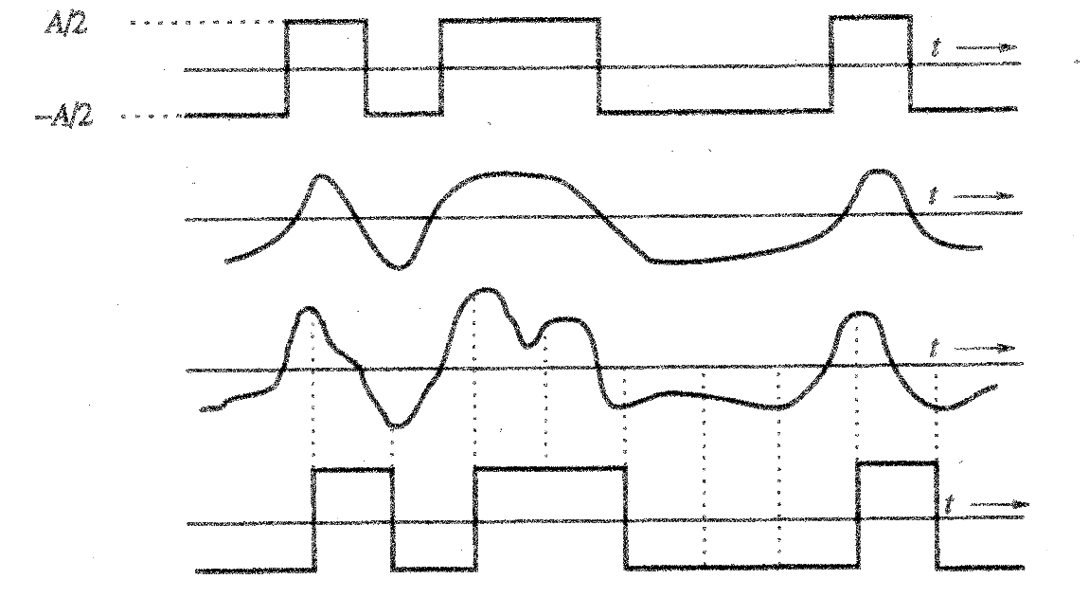
Noise Immunity
In a binary digital signal a "1" can be transmitted by an electric pulse of amplitude A/2, a "0" by a pulse of amplitude –A/2
Receiver must only decide, if the signal level is above 0 or not:
Transmitted signal
Received distorted signal without noise
Received distorted signal with noise
Regenerated signal

Slide 18
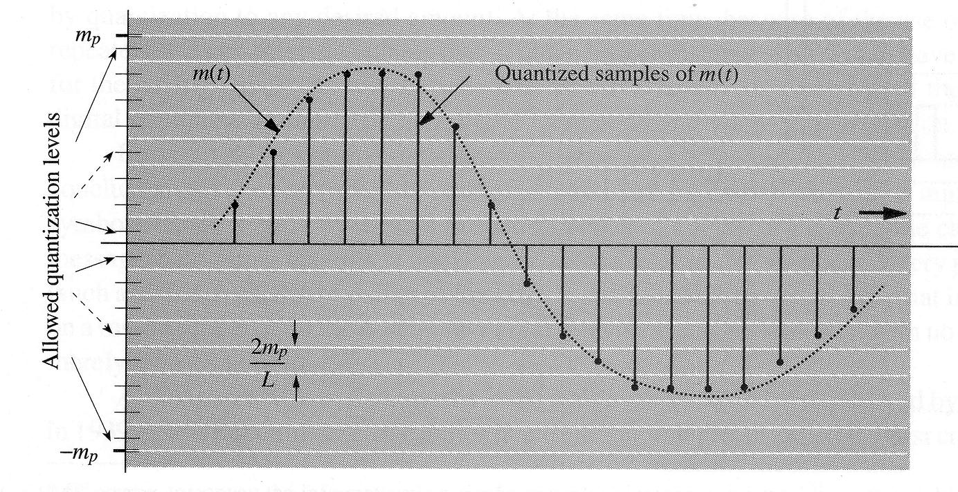
Analog to Digital conversion
An analog signal is converted to a digital signal by sampling and quantization

Slide 19
Analog to Digital conversion
The conversion of analog signals to digital signals is called analog-to-digital conversion, and the corresponding device is called A/D converter.
Conceptually, A/D conversion is a three step process.
Sampling: This is the conversion of a continuous-time signal into a discrete-time signal obtained by taking “samples” of the continuous-time signal at discrete time instants.
Quantization: This is the conversion of a discrete-time continuous-valued signal into a discrete-time, discrete-valued signal. The resultant signal is called digital signal.
Encoding: Each discrete value is represented by a binary sequence.

Slide 20
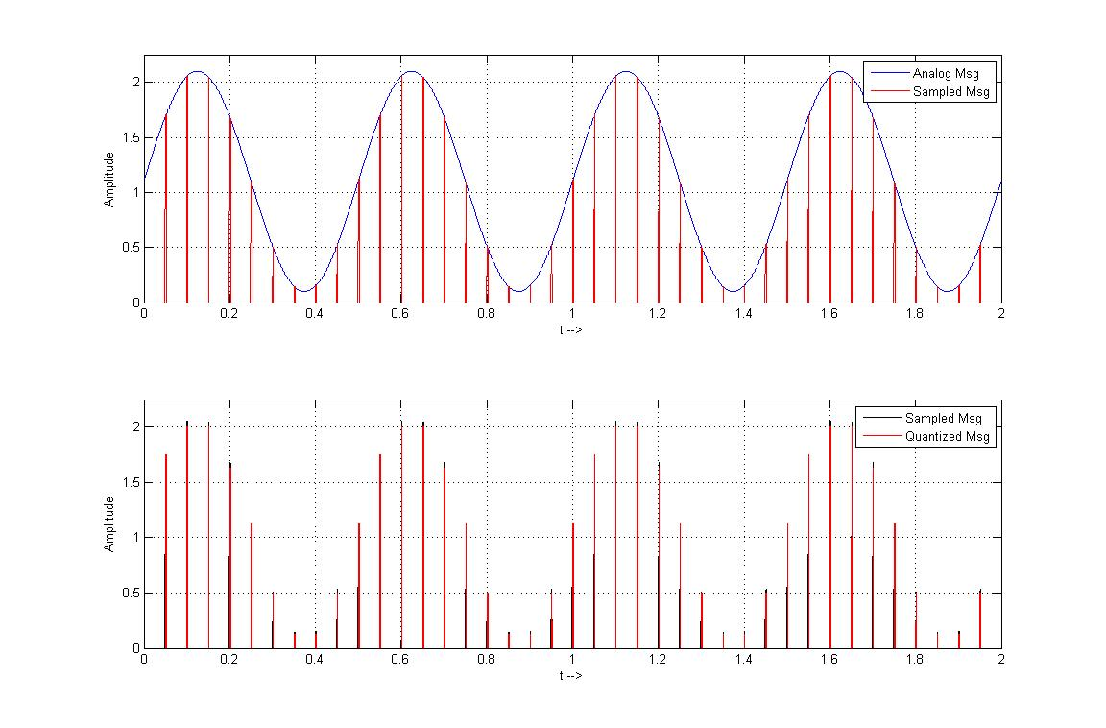

Slide 21
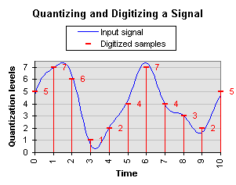

Slide 22
Analog to Digital conversion
The Nyquist theorem/sampling theorem (details later) states that the analog signal can be reconstructed from the samples, if
fsample > 2 fmax
(where fsample is the sampling frequency and fmax is the highest signal frequency)
For quantization the range of the amplitude (–mp, mp) is partitioned into L intervals, each of magnitude m = 2 mp/L
At each sample point the amplitude is approximated by the midpoint of the interval in which the sample value falls.
The unavoidable approximation error can be decreased by increasing the number L of levels.
For understanding a voice signal, L = 16 levels are sufficient; a higher quality speech signal requires at least L = 256 levels

Slide 23
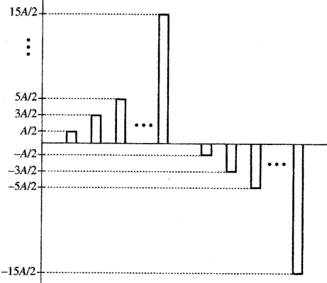
Analog to Digital conversion
The quantized signal can be transmitted over a channel by using a multiamplitude pulse-code with L signal levels. e.g. ± A/2, ± 3A/2, ± 5A/2... , ± (L–1)A/2
Example for L = 16:

Slide 24
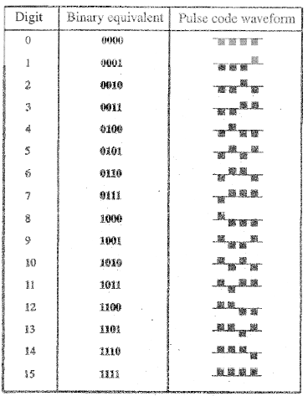
Analog to Digital conversion
The idea of PCM is to represent each quantized sample by an ordered combination of two basic pulses (0, 1).
Because each of the L possible sample values can be written as a bit string of length of log₂L, each sample can therefore be mapped into a short pulse sequence that represents the binary sequence of bits.
For example, if L=16, then, each quantized level can be described uniquely by 4 bits.
Each quantized level is now coded into a sequence of 4 binary pulses.

Slide 25
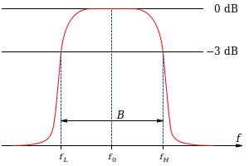
Bandwidth
Bandwidth is the range of frequencies that a channel can pass with reasonable fidelity
Bandwidth = f_{H} – f_{L}
For example,
lowest frequency f₁= 300 Hz
highest frequency f₂= 4000 Hz
Bandwidth B= f2 - f1
= 4000-300
=3700 Hz

Slide 26
Channel Capacity
The maximum rate at which data can be transmitted over a communication path is called channel capacity.
The rate, in bits per second, at which data can be communicated is called data rate.
A high signal-to-noise ratio (SNR) is required for a high quality communication
SNR = power of signal / power of noise
Shannon capacity formula: C= B log₂ (1+ SNR) bits/s
C is the capacity of the channel in bits per second. In other words, C is the maximum number of bits that can be transmitted per second over a communication channel.
B is the bandwidth of channel in hertz.

Slide 27
Thank you

